Slide 1


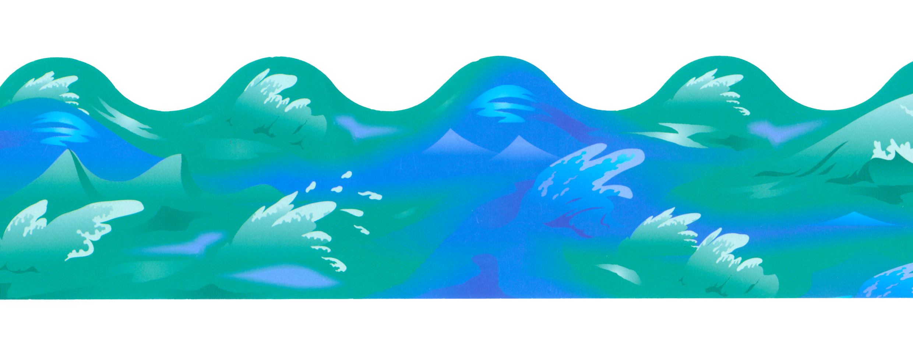
As a Mariner
Learning engineering systems from hands on experience
Photojournalism school and life in Japan
Valuable working and living experience abroad

Slide 2

Skills and Knowledge
Photojournalism and Aesthetics
How good applications are made and what makes good application
Software for smart phones as well as PCs

Slide 3
In Class Games
IWB games to enhance hands on teaching
Using games and software in the classroom
Building a library of games teachers can chose from

Slide 4

After Class Learning
Use of WeChat for students and teacher
Practice at home all week long
A simple to use mobile app for students and teachers

Slide 5

Vision and Experience
A familiar industry
In classroom experience
Driven to help kids enjoy learning

Slide 6
Sources
ocean waves : http://cliparts.co/cliparts/Aib/K9n/AibK9n8ET.jpg
sun clip art : http://cliparts.co/clipart/28142
35 mm film strip : https://openclipart.org/detail/62725/35mm-camera-film
Super Mario .gif http://selmiak.bplaced.net/games/nes/smb/img/1-1.gif
WeChat: http://postear.net/wp-content/uploads/2015/06/WeChat.jpg
cloud: http://www.clker.com/cliparts/f/5/6/f/13407405181278730107Cloud%20in%20the%20Sky.svg.hi.png

